Slide 1
EEKE 2024
Biomedical Relation Extraction via Domain Knowledge and Prompt Learning
Author: Jianyuan Yuan¹, Wei Du¹, Xiaoxia Liu², Yijia Zhang^{1∗}
School of Information Science and Technology, Dalian Maritime University
Department of Neurology and Neurological Sciences, Stanford University

Slide 2
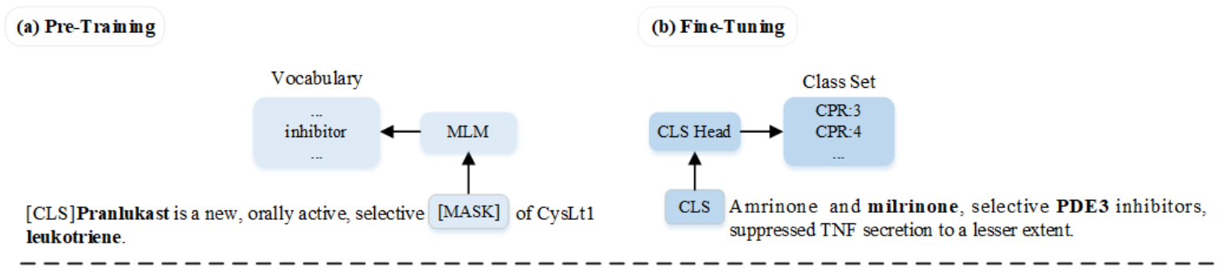
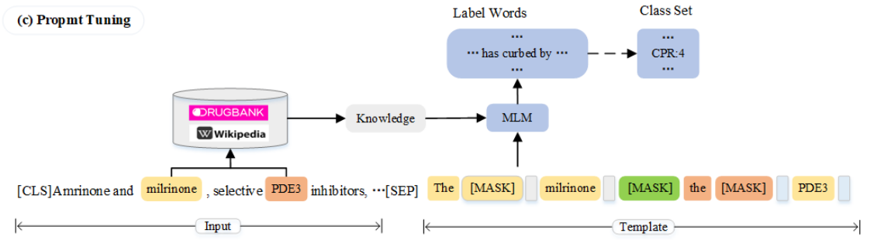
Motivation
2

Slide 3
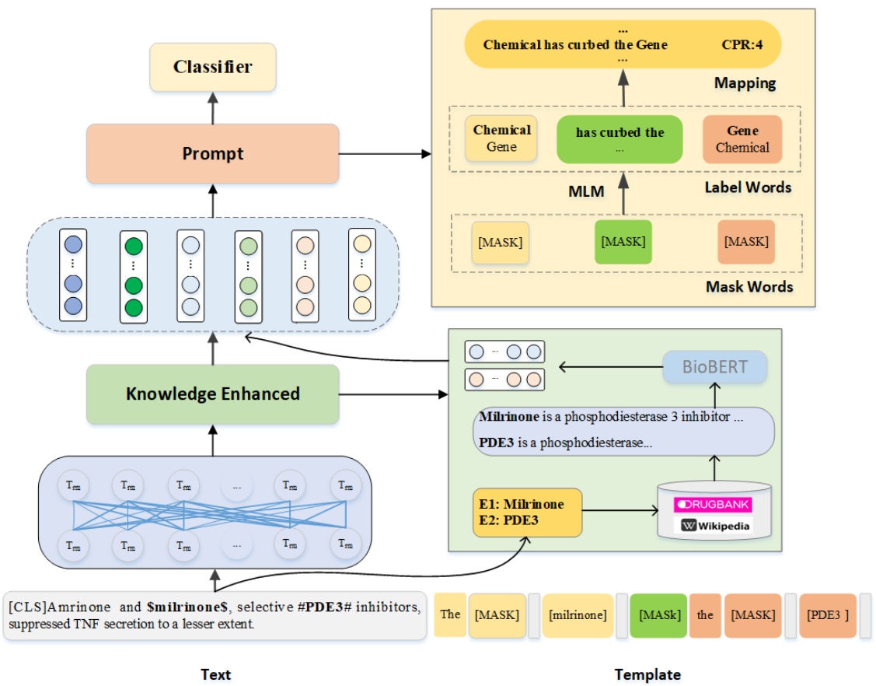
Our Method
The overall architecture of the model
3

Slide 4
Our Method
Encode Module
4

Slide 5
Our Method
Knowledge Enhancement Module
5

Slide 6
Our Method
Prompt Learning Module
6

Slide 7
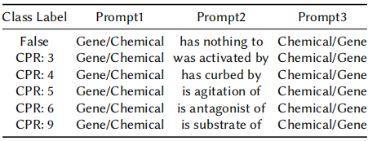
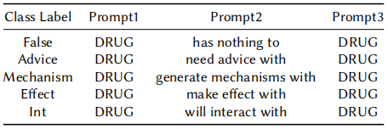
拟研究路线
Experiments
Label words
The label words for the prompt of the CPI dataset
The label words for the prompt of the DDI dataset
7
Notes:
.

Slide 8
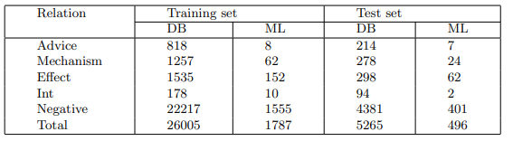
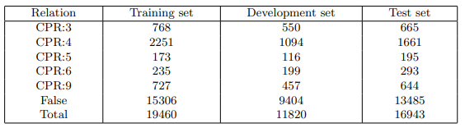
拟研究路线
Experiments
Datasets
Drug-Drug Interaction (DDI) dataset
Chemical-Protein Interaction (CPI) dataset
8

Slide 9
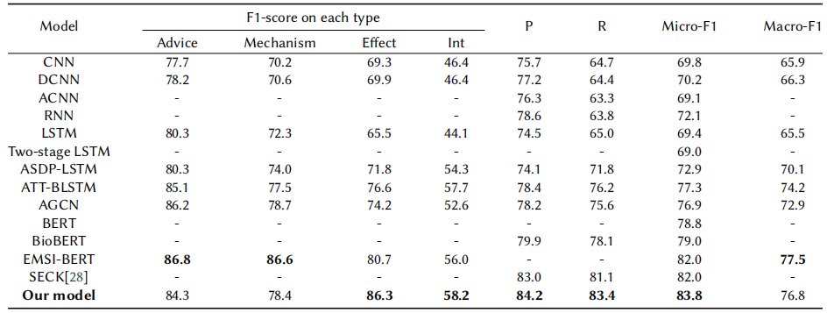
拟研究路线
Experiments
Main Results on the DDI Dataset
9

Slide 10
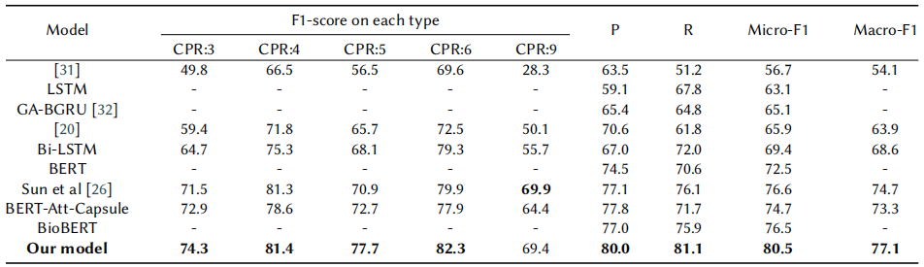
拟研究路线
Experiments
Main Results on the CPI dataset
10

Slide 11
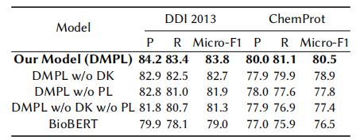
拟研究路线
Experiments
Ablation study
“DK” is the Knowledge Enhancement module and “PL” is the Prompt Learning module.
11

Slide 12
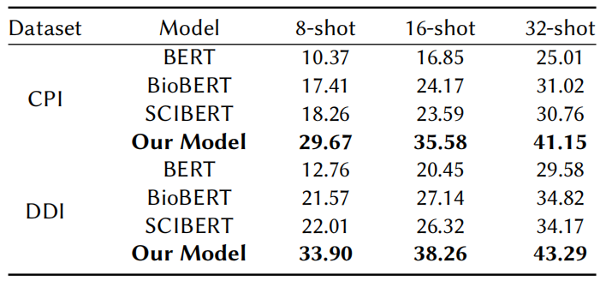
拟研究路线
Experiments
Low-resource analysis
12

Slide 13
Conclusions
We incorporate external domain information to improve the model’s ability to comprehend domain-specific terms in biomedical texts .
We further develop a prompt learning, which can guide the model to focus on key features and information from limited data by constructing multiple task-related prompt for biomedical relation extraction.
Our method achieves state-of-the-art biomedical relation extraction results on two benchmarks (DDI, ChemProt).
13

Slide 14
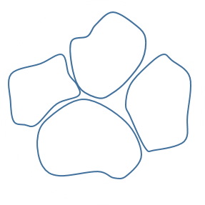
Thanks for listening！

